Slide 1
Multiscale global atmosphere model SL-AV: applications for numerical weather prediction, climate change modelling using massively parallel computers
Tolstykh Мikhail (1,2)
Fadeev Rostislav (1,2), Shashkin Vladimir (1,2), Goyman Gordey (1,2) Volodin Evgueni (1),
(1) Marchuk Inst. of Numerical Mathematics RAS
(2) Russian Hydrometeorological Research Centre

Slide 2
Seamless prediction across the scales:
There are no artificial borders between the scales in the atmosphere (Shukla, 2005; Hoskins, QJ 2013).
A ‘good’ atmosphere model should reproduce all the time scales correctly inside the same set of parameterizations for subgrid-scale processes.
«Seamless prediction» models: Germany, UK MetOffice, USA.
We extend SL-AV model initially developed for NWP for application on ranges from days to years

Slide 3
Sources of predictability at subseasonal scales (Vitart, 2012)
Sea surface temperature
Land surface conditions (surface temperature, snow coverage, vegetation characteristics, land use, albedo,
Madden-Julian oscillation (MJO)
North Atlantic oscillation – Arctic oscillation (NAO )
Stratosphere variability (sudden stratosphere warmings, quasi biennial oscillation, …)
Sea ice, its thickness
At seasonal scale: + El Nino- Southern Oscillation

Slide 4
Subseasonal and seasonal forecasts
12 +1 WMO Global producing centers
Russia: Global producing center (HMCR), NEACC (HMCR+MGO). It participates in APCC MME, WMO S2S projects
Mostly successful in tropics. Mid- and high-latitudes: some spots.
‘Smooth’ fields (i.e. MSLP, H500) have higher predictability

Slide 5
SL-AV global atmosphere model (1)
SL-AV: Semi-Lagrangian, based on Absolute Vorticity equation
Finite-difference semi-implicit semi-Lagrangian dynamical core of own development. Vorticity-divergence formulation, unstaggered grid (Z grid), 4th order finite differences
Possibility to use reduced lat-lon grid in dynamical core. (Tolstykh, Shashkin JCP 2012; Shashkin, Fadeev Tolstykh, JCP 2016;Tolstykh, ShashkinTolstykh et.al., Geosci.Mod.Dev., 2017).
Mass-conserving version (Shashkin, Tolstykh GMD 2014)

Slide 6
SL-AV global atmosphere model
Many parameterizations algorithms for subgrid-scale processes developed by ALADIN/ALARO consortium.
Parameterizations for shortwave and longwave radiation: CLIRAD SW + RRTMG LW.
INM RAS- SRCC MSU multilayer soil model (Volodin, Lykossov, Izv. RAN 1998).
Marine stratocumulus parameterization

Slide 7
Current applications of SL-AV model:
Operational medium-range weather prediction up to 10 days; probabilistic seasonal forecast at Hydrometcentre of Russia.
Weather prediction up to 3 days at Novosibirsk.
60 days weekly forecast (S2S Prediction project, WMO) – quite old SL-AV version ! Need of urgent update

Slide 8
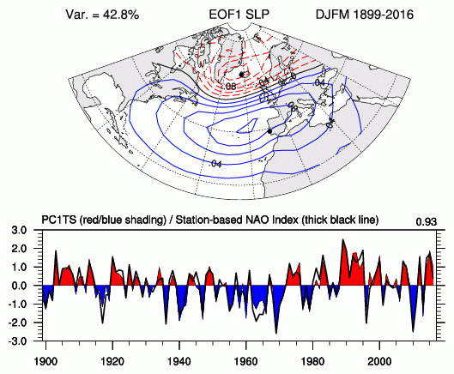
North-Atlantic Oscillation index
Winter index is relatively predictable by the models !
Notes:
Positive NAO Index
The Positive NAO index phase shows a stronger than usual subtropical high pressure center and a deeper than normal Icelandic low.
The increased pressure difference results in more and stronger winter storms crossing the Atlantic Ocean on a more northerly track.
his results in warm and wet winters in Europe and in cold and dry winters in northern Canada and GreenlandThe eastern US experiences mild and wet winter conditions
Negative NAO Index
The negative NAO index phase shows a weak subtropical high and a weak Icelandic low. The reduced pressure gradient results in fewer and weaker winter storms crossing on a more west-east pathway. They bring moist air into the Mediterranean and cold air to northern Europe. The US east coast experiences more cold air outbreaks and hence snowy weather conditions. Greenland, however, will have milder winter temperatures

Slide 9
Old seasonal SL-AV version: reproduction of NAO index
Correlation: 0.3
Currently, best models (UKMO) have 0.62
Courtesy of V. Khan

Slide 10
Correlations of winter NAO index and T2m: old SL-AV model (left) and NCEP/NCAR2 reanalysis (right)
Courtesy of V.Khan
Making NAO forecast better would provide practically useful winter T2m seasonal forecast over significant part of Russia

Slide 11
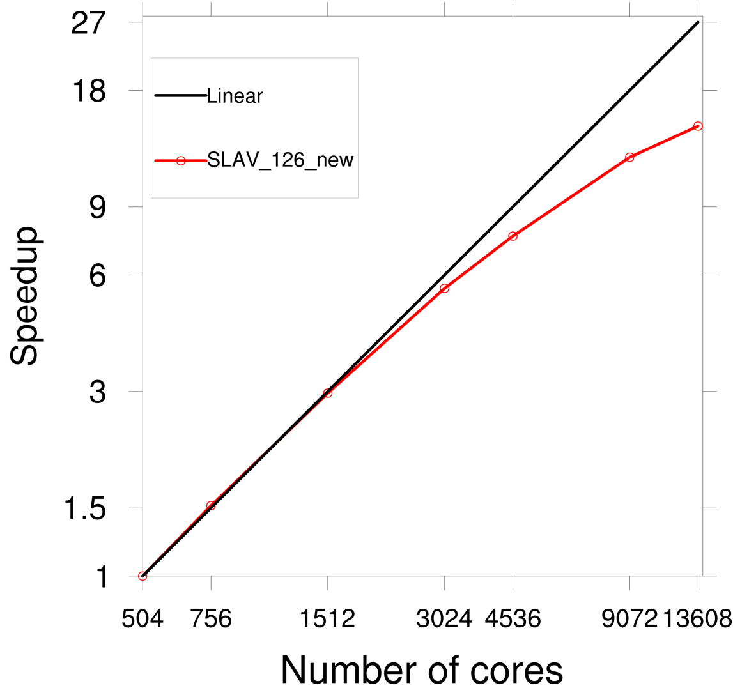
.
SL-AV code parallel speedup at Cray XC40 w.r.t to 504 cores
Horizontal grid of 3024х1513 points (~13 km). 126 vertical levels

Slide 12
Tasks for making SL-AV model suitable for long range forecasts
description of stratosphere processes
(Scaiffe et al GRL 2005)
better description of ‘boundary layer – convection-cloudiness’ complex

Slide 13
SL-AV model developments in 2017 (1)
Modernized deep convection parameterization
New shallow convection parameterization.
Modified cloudiness and microphysics parameterizations.
New boundary layer parameterization algorithm (Bastak-Duran,Geleyn,Vana, JAS 2014)

Slide 14
SL-AV model developments in 2017 (2)
1. The 85-level grid (0.3 hPa) (from 100 to 10 hPa – mesh size of 500 to 700 m, upper – increase to 1 km).
2. Finite-element scheme for hydrostatics equation
3. Incorporation of convective gravity-wave drag parameterization (Hines 97) as implemented in INM RAS model.
4. Tuning of p. 1 -3

Slide 15
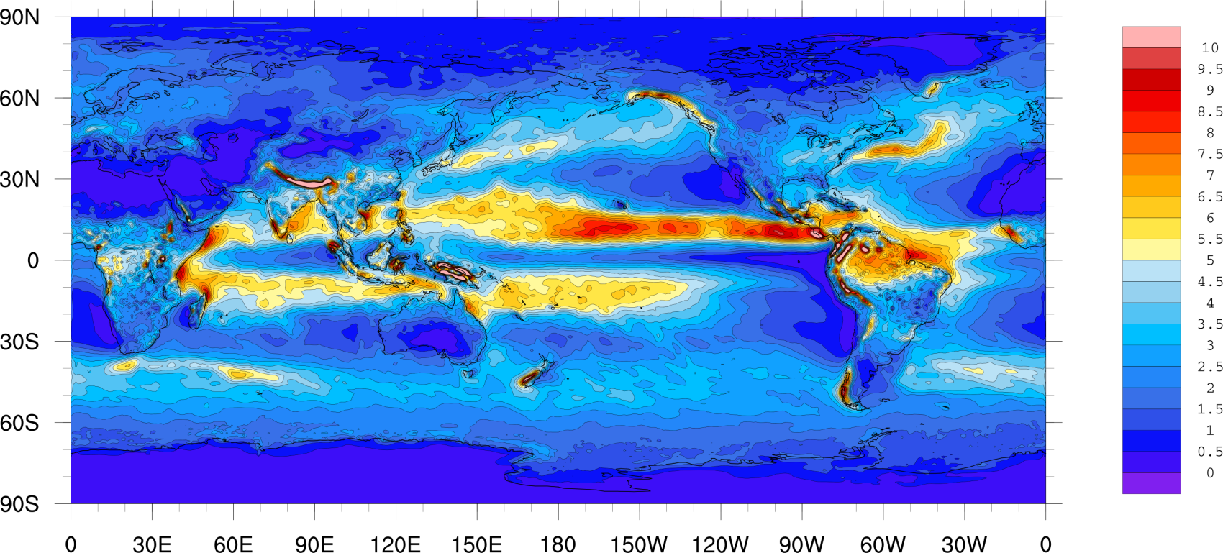
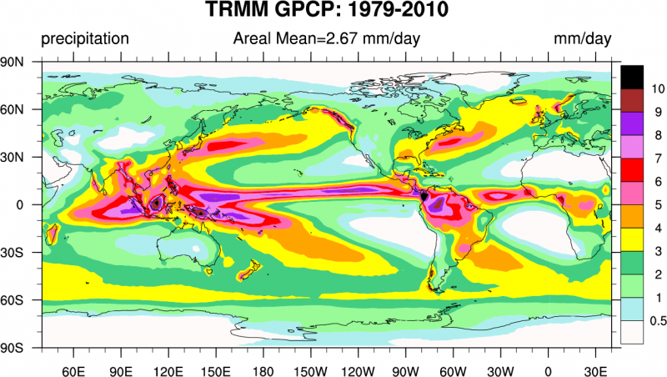
Annual mean precipitation (mm/day)
SLAV, 85 lvl, 2018
SLAV, 28 lvl, 2016
Obs GPCP
TRMM
(1979-2010)
TRMM: TROPICAL RAINFALL MEASURING MISSION. https://climatedataguide.ucar.edu/climate-data/trmm-tropical-rainfall-measuring-mission

Slide 16
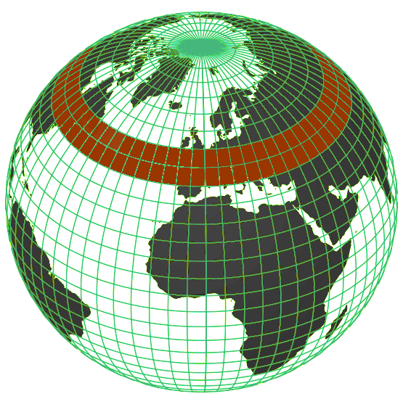
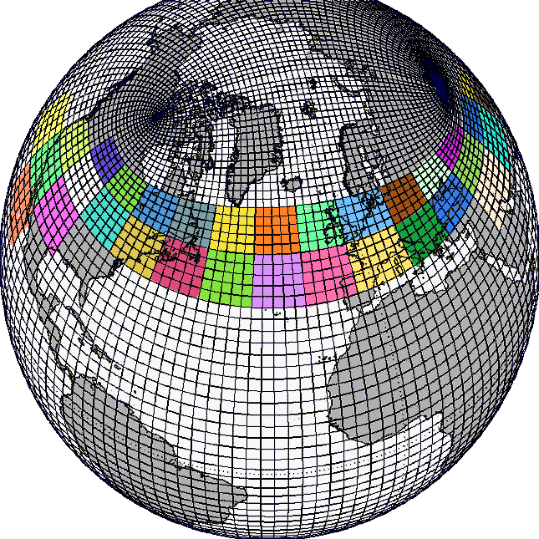
Coupled model components
SLAV atmosphere model
0.9ºx0.72º (400x250), 85 levels.
Δt = 1440 s.
Lat-Lon, 1D MPI decomposition.
* includes multilayer soil model.
INMIO World ocean model
0.5ºx0.5º (720x360), 49 levels.
Δt = 600 s.
Tri-polar grid, 2D MPI decomposition.
Tolstykh et al, GMD, 2017;
Ibrayev et al, Izv AOP, 2012;
Fadeev et al, RJNAMM, 2016.

Slide 17
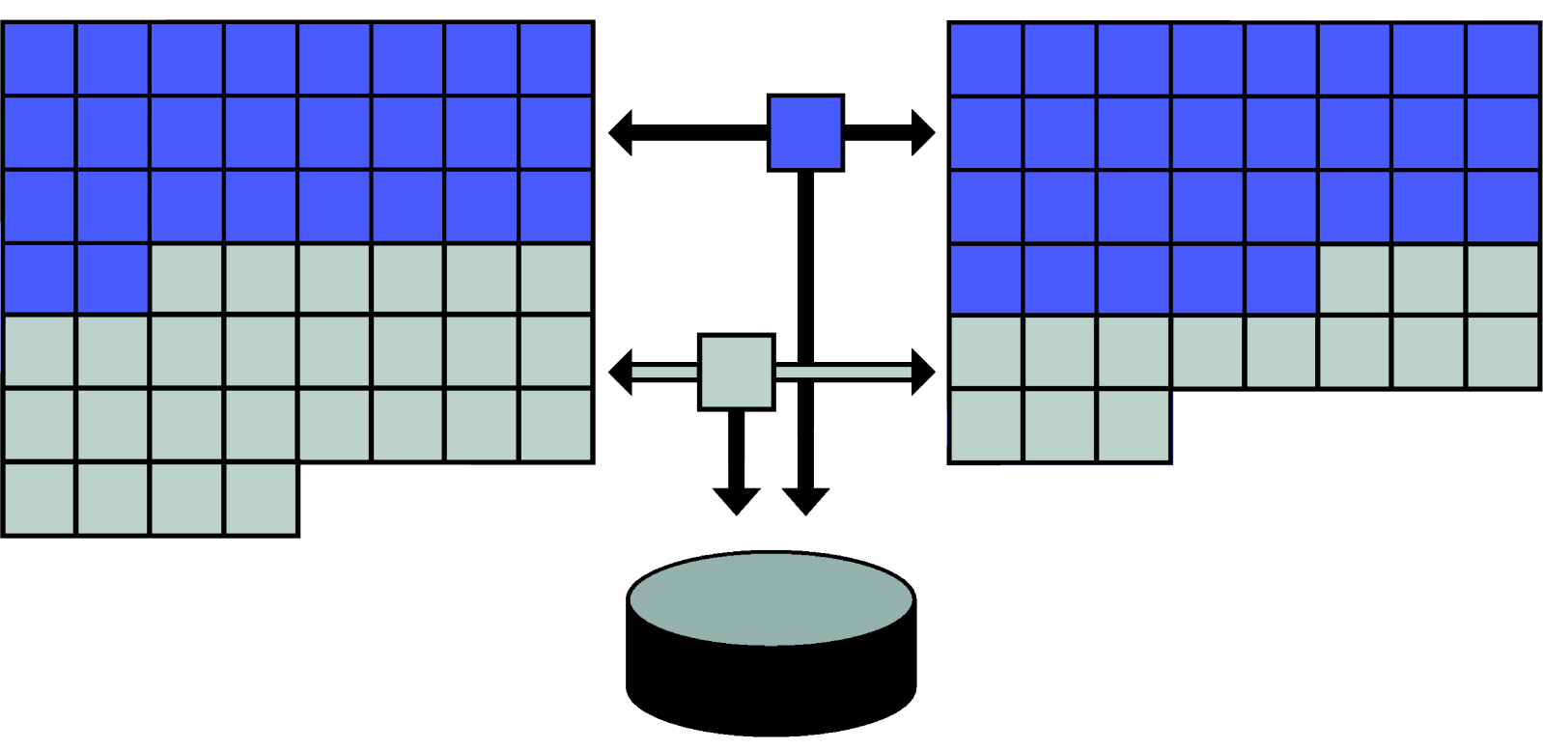
Coupled model structure
Atmosphere
Coupler
Ocean
Comp. Core.
Color: MPI decomposition.
File system
Coupler: synchronize the components, transfer (with interpolation) data between them, works with file system.
Data flow: 9 fields from atm to ocean every 2 hour,
3 fields from ocean to atm every 4 hour.
Efficiency: 2 years/day on 258 cores (ATM 125, OCN 132, CPL 1).

Slide 18
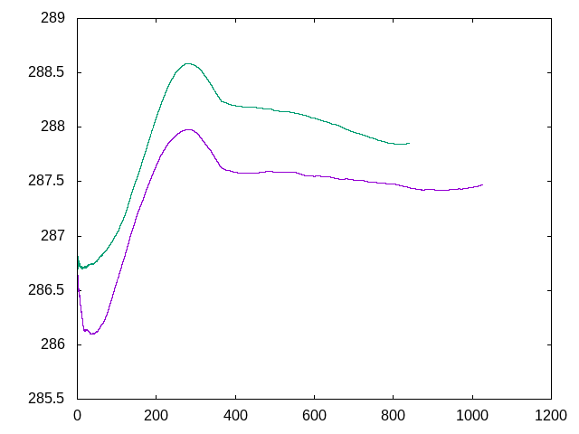
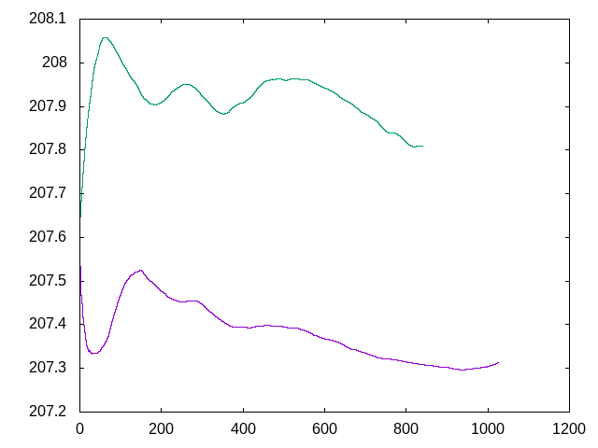
Global mean surface temperature (left), SST (right).
SLAV + INMIO
SLAV + INMIO
Совместная модель
SLAV + prescribed ocean
Предписанный океан
prescribed ocean
day

Slide 19
These improvements in model climate produced a reduction of operational medium range forecasts errors
Operational version of the model: resolution in longitude 0,225°, in latitude from 0,16° in NH to 0,245° in SH, 51 vertical levels
https://apps.ecmwf.int/wmolcdnv/

Slide 20
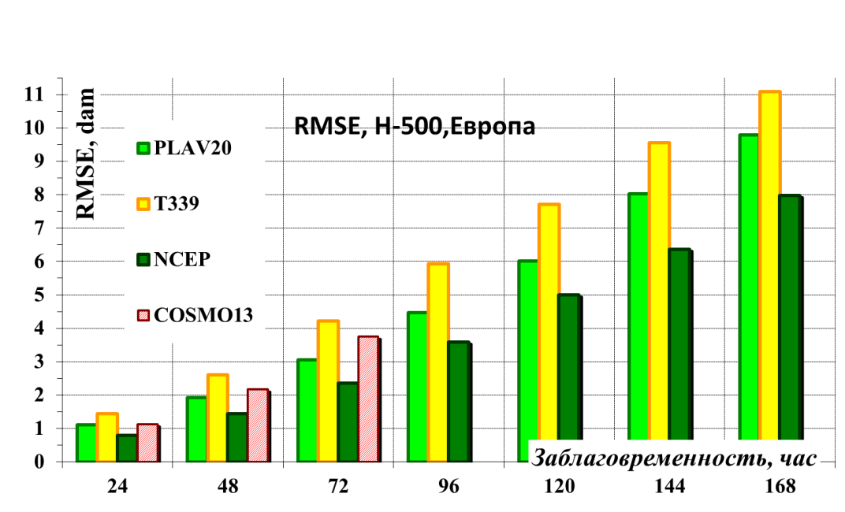
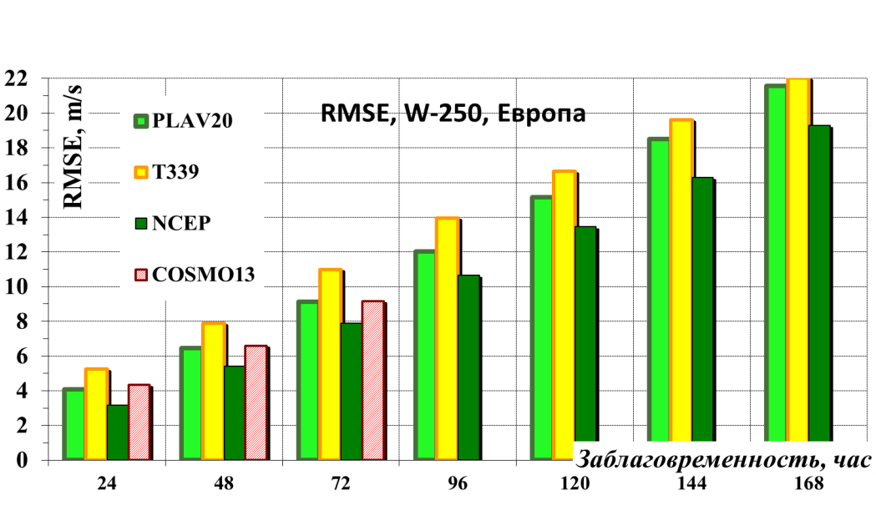
RMS errors of forecasts by different models over Europe averaged over 16.12.2017-07.05.2018 (computed in RHMC)

Slide 21
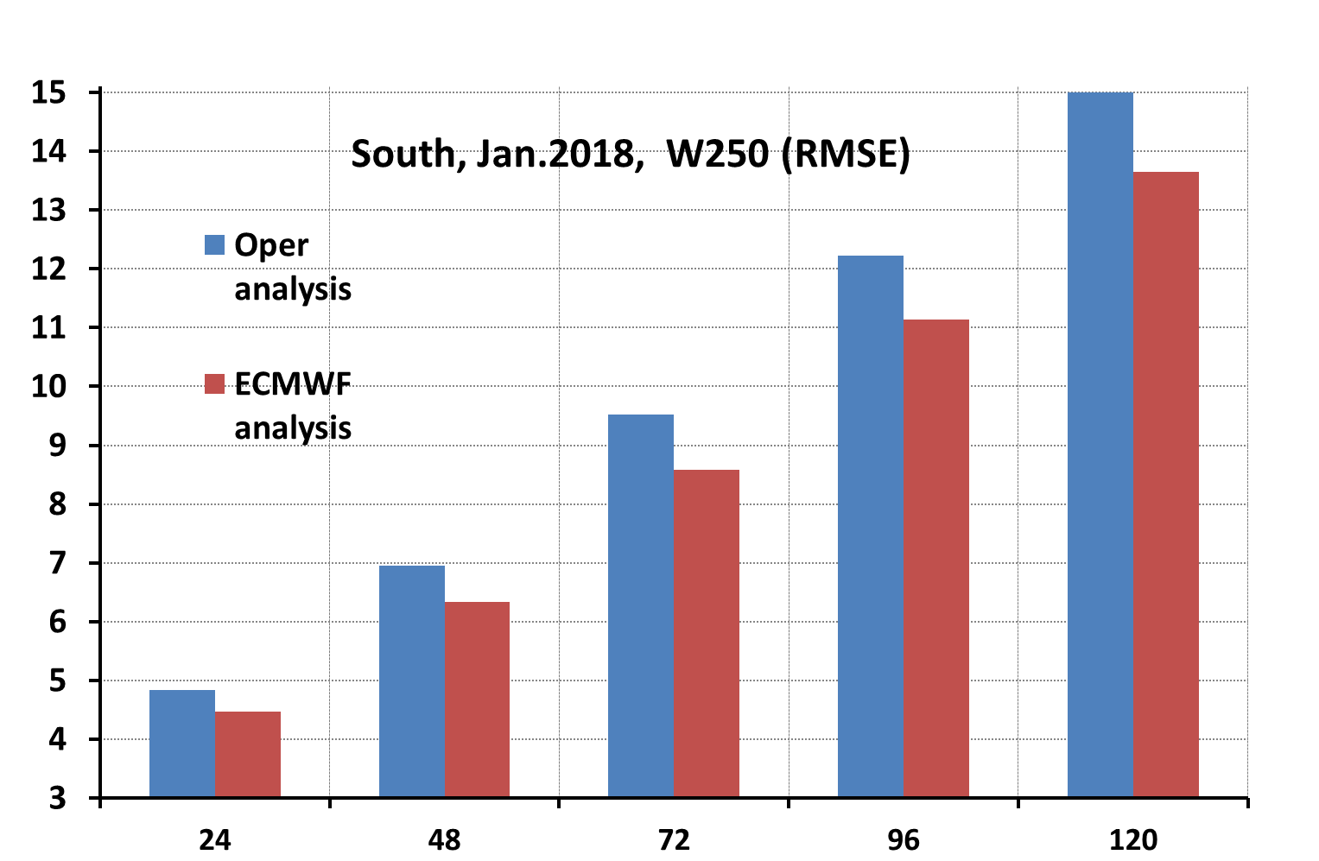
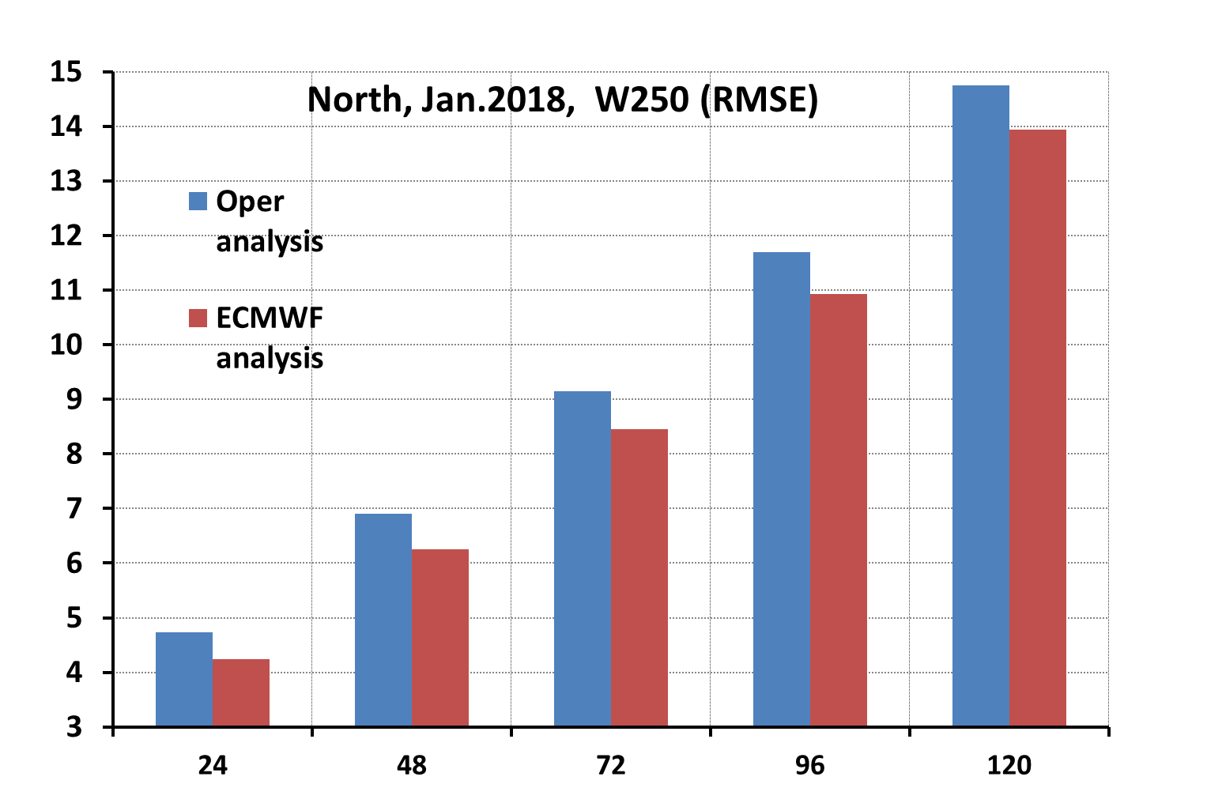
Improvements in RMS forecast error while using ECMWF initial data (Southern extratropics - left, Northern ones – right; top - H500 , bottom- W250)
Reduction in 72 hrs forecast error: geopotential – 2-4 m, wind ~ 0.8 m/s.

Slide 22
Conclusions
New version of SL-AV model with 85 vertical levels reproduces main characteristics of modern climate, including stratosphere oscillations.
Improvements in model climate helped to reduce medium-range forecasts errors.
===========================================
Further modernization of SL-AV model is foreseen – Monte-Carlo independent column approach, deep convection parameterization with memory

Slide 23
Thank you for attention!
http://nwplab.inm.ras.ru

